Slide 1
L2. Basics of Deep Learning for Computer Vision
Oleksandr Baiev, PhD
Head of Machine Perception Lab
Samsung R&D Institute Ukraine

Slide 2
Course overview
L1. Introduction to Computer Vision
L2. Basics of Deep Learning for Computer Vision
P1. Tensorflow basics
L3. Instance Recognition
P2. Train Simple Model
P3. Model Improvement. Pre-trained models

Slide 3
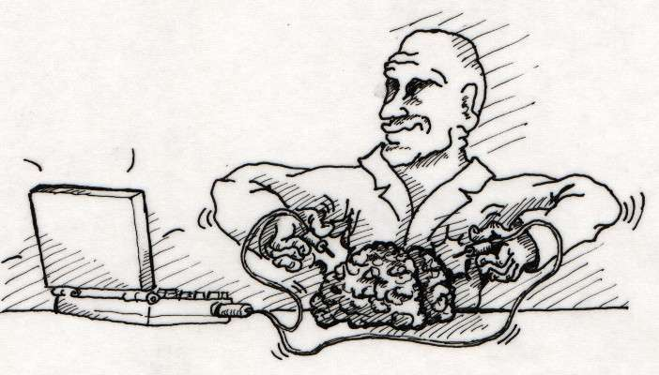
Artificial Neural Networks and Biology
Simulation of biological neural networks (synapses, axons, chains, layers, etc.) is a good high level abstraction.
Bio NN is inspiration and illustration only. Nothing more!

Slide 4
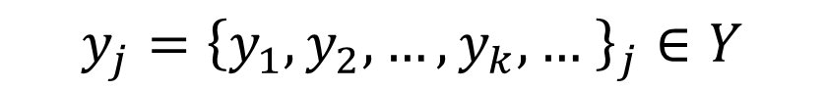

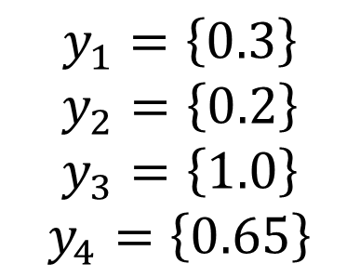
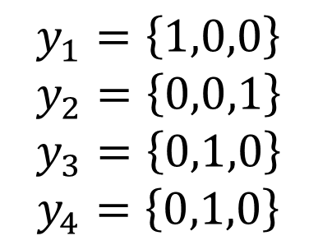

Solution in general
$${x_{j}=\left\{x_{1},x_{2},x_{3},x_{4},…,x_{i},…\right\}}_{j}∈ X$$
$${y_{j}=\left\{y_{1},y_{2},…,y_{k}, … \right\}}_{j}∈Y$$
$$F:X→Y$$
Classification
Regression
$$y_{1}=\left\{1,0,0\right\}$$
$$y_{2}=\left\{0,0,1\right\}$$
$$y_{3}=\left\{0,1,0\right\}$$
$$y_{4}=\left\{0,1,0\right\}$$
sample of class “0”
$$y_{1}=\left\{0.3\right\}$$
$$y_{2}=\left\{0.2\right\}$$
$$y_{3}=\left\{1.0\right\}$$
$$y_{4}=\left\{0.65\right\}$$
sample of class “2”
sample of class “1”
sample of class “2”
Index of sample in dataset

Slide 5
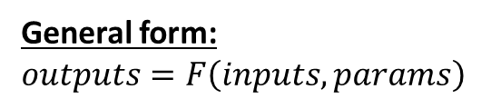
F
inputs
outputs
parameters
Steps:
choose “form” of F
find parameters
General form:
$$outputs=F\left(inputs, params\right)$$

Slide 6
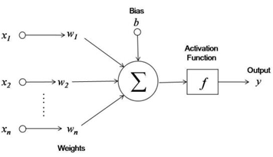
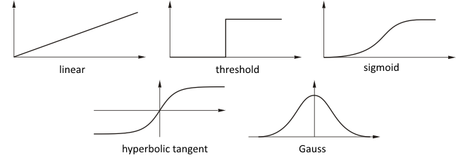
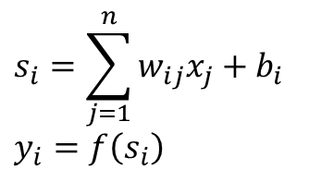
Artificial Neural Networks and Simple Math
Output of i-th neuron:
$$s_{i}=\sum_{j=1}^{n}{w_{ij}x_{j}}+b_{i}$$
$$y_{i}=f\left(s_{i}\right)$$
free parameters
activation function

Slide 7
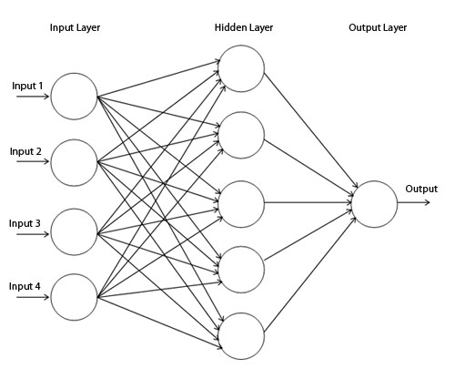
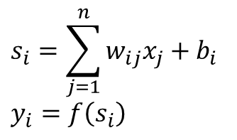
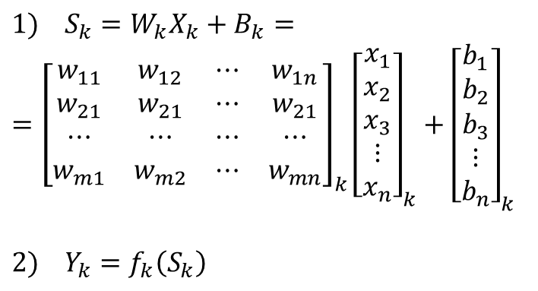
Artificial Neural Networks and Simple Math
Output of i-th neuron:
Kolmagorov & Arnold function superposition
$$s_{i}=\sum_{j=1}^{n}{w_{ij}x_{j}}+b_{i}$$
$$y_{i}=f\left(s_{i}\right)$$
Form of F:
Output of k-th layer:
$$1) S_{k}=W_{k}X_{k}+B_{k}=$$
$$={\left[\begin{matrix}w_{11} & w_{12} & ⋯ & w_{1n} \\ w_{21} & w_{21} & ⋯ & w_{21} \\ ⋯ & ⋯ & ⋯ & ⋯ \\ w_{m1} & w_{m2} & ⋯ & w_{mn}\end{matrix}\right]}_{k}{\left[\begin{matrix}x_{1} \\ x_{2} \\ x_{3} \\ ⋮ \\ x_{n}\end{matrix}\right]}_{k}+{\left[\begin{matrix}b_{1} \\ b_{2} \\ b_{3} \\ ⋮ \\ b_{n}\end{matrix}\right]}_{k}$$
$$2) Y_{k}=f_{k}\left(S_{k}\right)$$
m neurons in hidden layer
n inputs
Matrices => simple parallel implementation!
apply element-wise

Slide 8
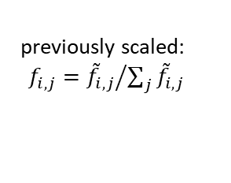
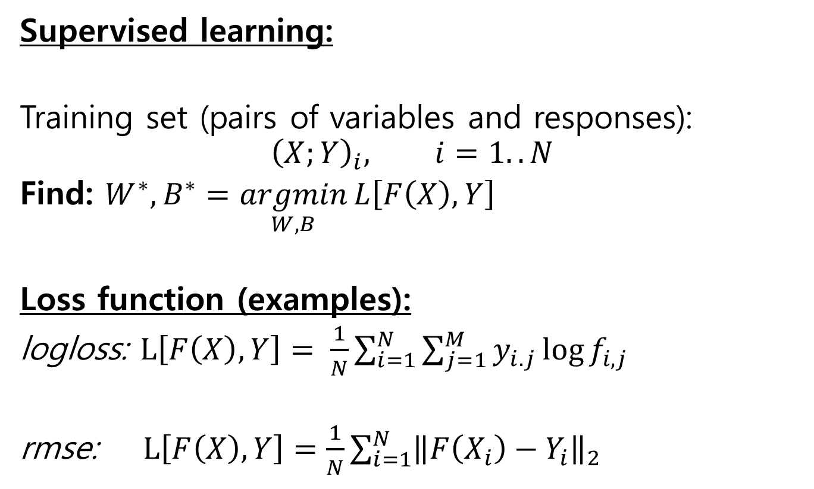
How to find parameters W and B?
Supervised learning:
Training set (pairs of variables and responses):
$${\left(X;Y\right)}_{i}, i=1..N$$
Find: $W^{∗}, B^{∗}=\underset{W,B}{argmin}{L\left[F\left(X\right), Y\right]}$
Loss function (examples):
logloss: $L\left[F\left(X\right), Y\right]= \frac{1}{N}\sum_{i=1}^{N}{\sum_{j=1}^{M}{y_{i.j}\log{f_{i,j}}}}$
rmse: $L\left[F\left(X\right), Y\right]=\frac{1}{N}\sum_{i=1}^{N}{{\left\|F\left(X_{i}\right)−Y_{i}\right\|}_{2}}$
“1” if in i-th sample is class j else “0”
previously scaled: $f_{i,j}={{\tilde{f}}_{i,j}}/{\sum_{j}{{\tilde{f}}_{i,j}}}$
Just an examples.
Cost function depend on problem (classification, regression) and domain knowledge

Slide 9
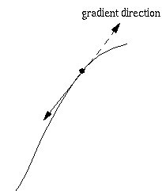
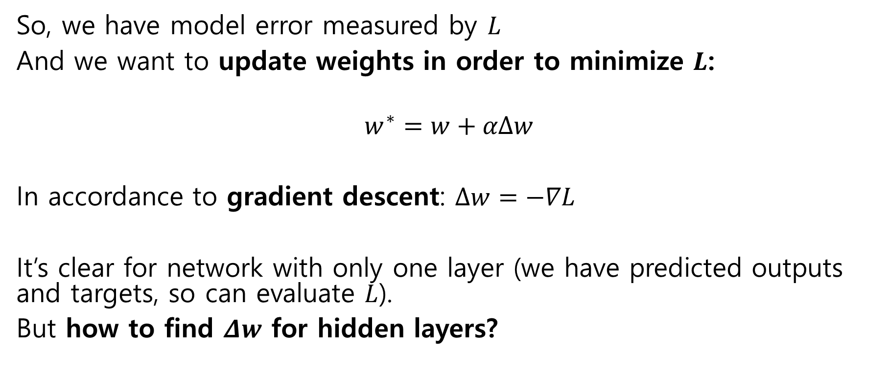
Training or optimization algorithm
So, we have model error measured by $L$
And we want to update weights in order to minimize $L$:
$$w^{∗}=w+αΔw$$
In accordance to gradient descent: $Δw=−∇L$
It’s clear for network with only one layer (we have predicted outputs and targets, so can evaluate $L$).
But how to find $Δw$ for hidden layers?

Slide 10
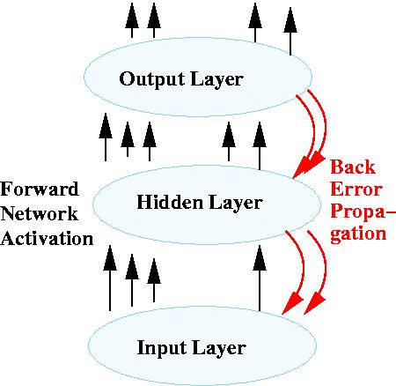

Error Backpropagation
Find $Δw$ for each layer from the last to the first as influence of weights to cost:
$−∆w_{i,j}^{}=\frac{∂L}{∂w_{i,j}^{}}$
and:
$\frac{∂L}{∂w_{i,j}^{}}=\frac{∂L}{∂f_{j}^{}}\frac{∂f_{j}^{}}{∂s_{j}^{}}\frac{∂s_{j}^{}}{∂w_{i,j}^{}}$

Slide 11
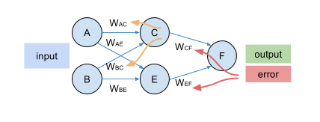

Error Backpropagation
$$\frac{∂L}{∂w_{i,j}^{}}=\frac{∂L}{∂f_{j}^{}}\frac{∂f_{j}^{}}{∂s_{j}^{}}\frac{∂s_{j}^{}}{∂w_{i,j}^{}}$$
$δ_{j}^{}=\frac{∂L}{∂f_{j}^{}}\frac{∂f_{j}^{}}{∂s_{j}^{}}$
$δ_{j}^{}=\left\{\begin{aligned}L^{′}\left[F\left(X\right), Y\right]f′\left(s_{j}^{}\right), output layer \\ \left(\sum_{l ∈ next layer}{δ_{l}w_{ j,l}}\right)f′\left(s_{j}^{}\right), hidden layers\end{aligned}\right.$
$$∆w_{i,j}^{}=−αδ_{j}^{}x_{i}^{}$$

Slide 12
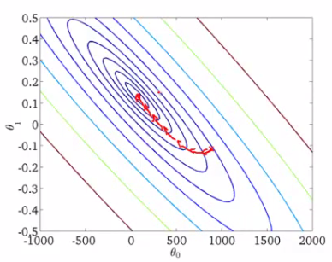
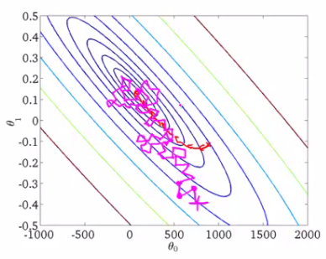
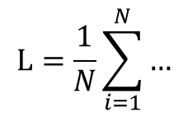
Gradient Descent. Stochastic & Minibatch
Stochastic GD
(L for each sample)
fast, but fluctuation
“Batch” GD
(L for full set)
need a lot of memory
Minibatch GD
(L for subsets)
less memory & less fluctuations
Size of minibatch depends on HW
$$L=\frac{1}{N}\sum_{i=1}^{N}{…}$$
Typical: minibatch=32…256

Slide 13
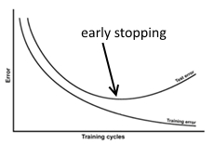
Termination Criteria
By epochs count
max number of iterations along all data set
By value of gradient
when gradient is equal to 0 than minimum, but small gradient => very slow learning
When cost didn’t change during several epochs
if error is not change than training procedure is not converges
Early stopping
Stop when “validation” score starts increase even when “train” score continue decreasing
Typical: epochs=50…200

Slide 14

What about “form” of F ? Network topology
“Shallow” networks 1, 2 hidden layers => not enough parameters => pure separation abilities
“Deep” networks is a NN with more than 2 layers

Slide 15
Fully Connected Layer
Compared to conv layers have huge amount of weights, but need less time to forward pass

Slide 16
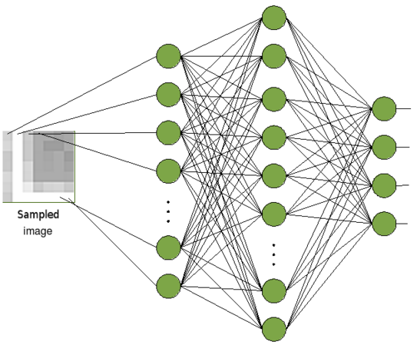
Neural Networks for Images
Image (matrix of pixels intensities) transforms to vector
Image 64x64: size of input layer 4096

Slide 17

Neural Networks for Images
Weights: 4096 * (size of second layer)
millions of parameters
tons of floats!!
Image (matrix of pixels intensities) transforms to vector
Image 64x64: size of input layer 4096

Slide 18
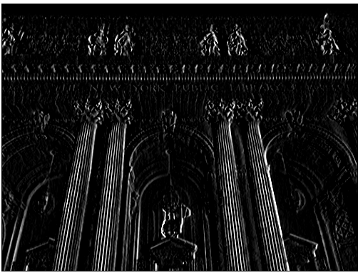
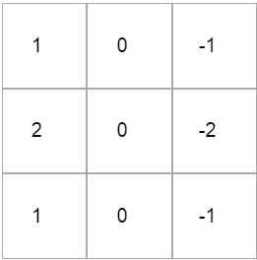
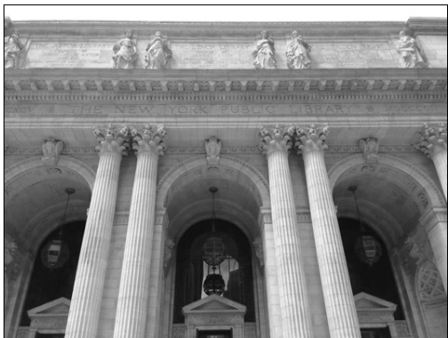
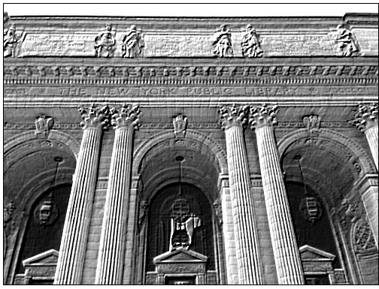
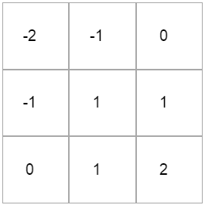
Convolutions
Sobel
Emboss

Slide 19
Convolution

Slide 20
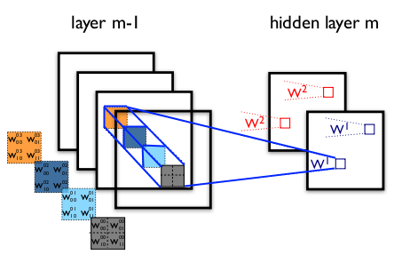
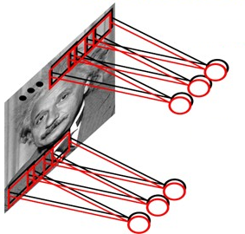
Convolution Layer

Slide 21
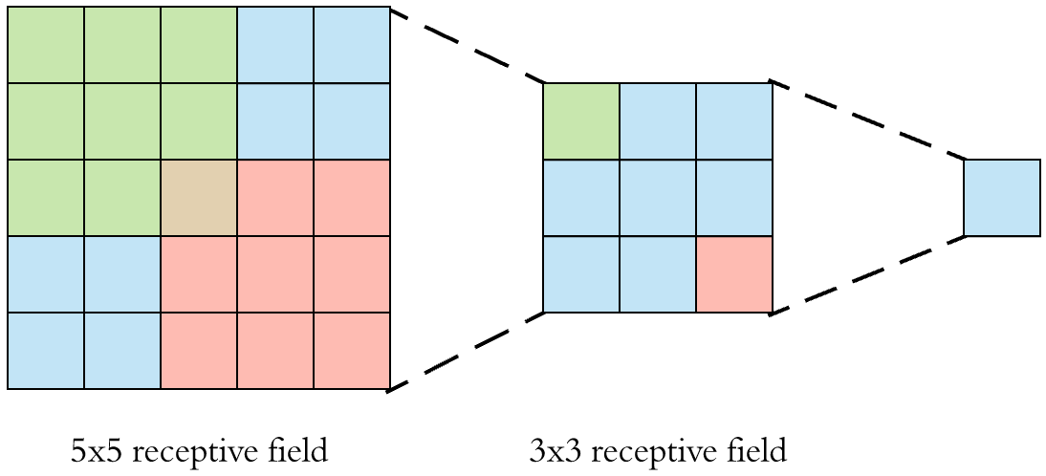
Effective receptive field

Slide 22
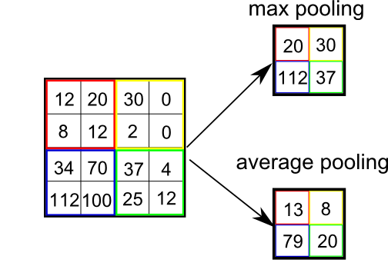
Pooling

Slide 23
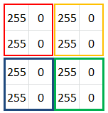
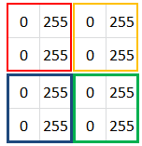
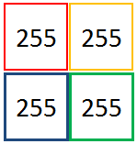
Pooling for Equivariance to Shifts
Apply MAX pooling
Apply MAX pooling

Slide 24
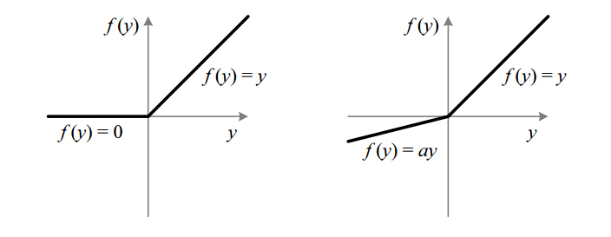
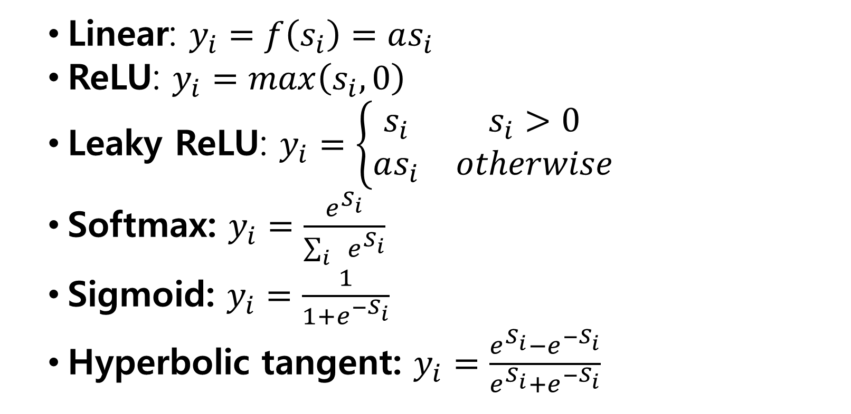
Activations
Linear: $y_{i}=f\left(s_{i}\right)=as_{i}$
ReLU: $y_{i}=max\left(s_{i},0\right)$
Leaky ReLU: $y_{i}=\left\{\begin{matrix}s_{i} & s_{i}>0 \\ as_{i} & otherwise\end{matrix}\right.$
Softmax: $y_{i}=\frac{e^{S_{i}}}{\sum_{i}{e^{S_{i}}}}$
Sigmoid: $y_{i}=\frac{1}{1+e^{{−S}_{i}}}$
Hyperbolic tangent: $y_{i}=\frac{e^{S_{i}}−e^{{−S}_{i}}}{e^{S_{i}}+e^{{−S}_{i}}}$
1

Slide 25
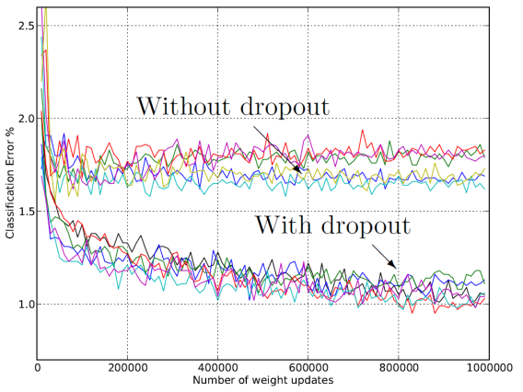
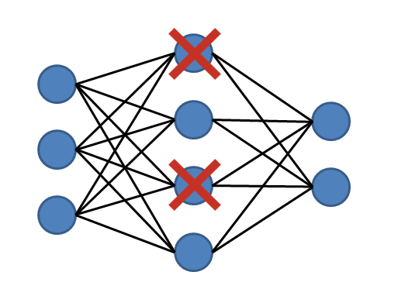

Dropout
Ensembles of networks
$2^{N}$ networks in one: for each example hide neurons output randomly ($P=0.5$)

Slide 26
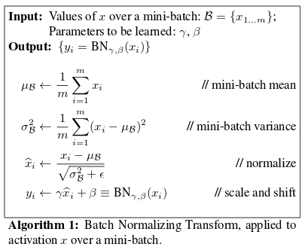
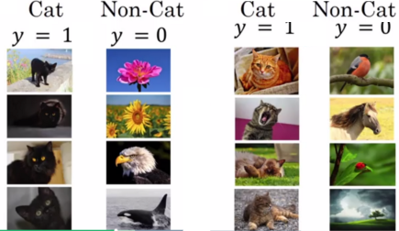
Batch Normalization
1
[1] Sergey Ioffe, Christian Szegedy Batch Normalization: Accelerating Deep Network Training by Reducing Internal Covariate Shift (2015)

Slide 27
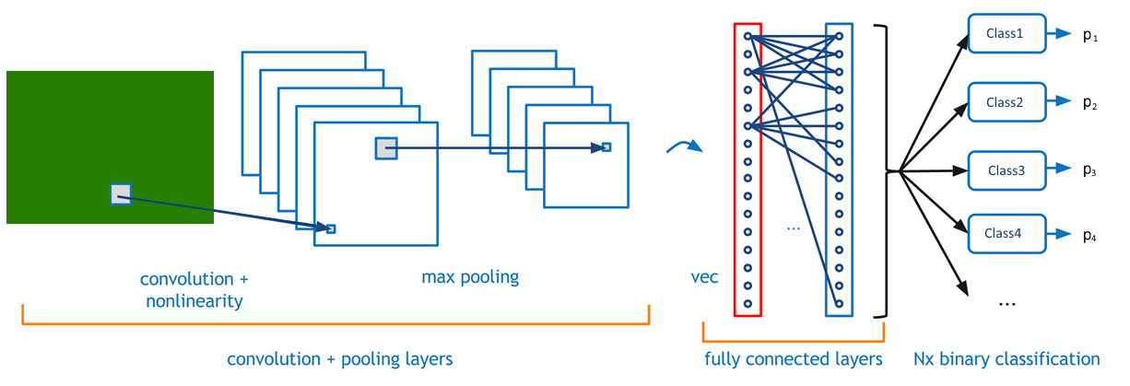
CNN basic structure

Slide 28
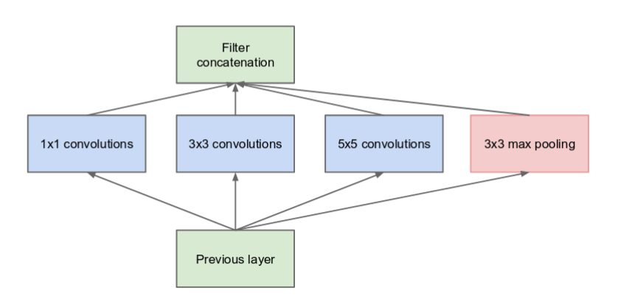
Inception block. Idea
[2] Christian Szegedy, Wei Liu, Yangqing Jia, Pierre Sermanet, Scott Reed, Dragomir Anguelov, Dumitru Erhan, Vincent Vanhoucke, Andrew Rabinovich Going deeper with convolutions (2014)

Slide 29
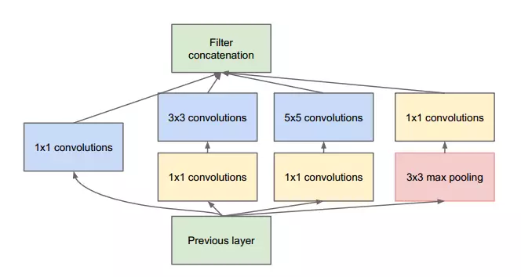
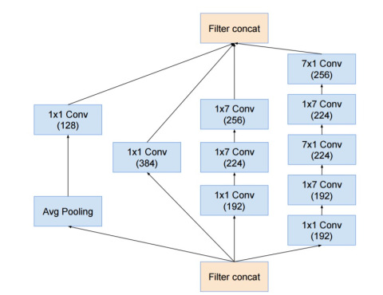
Inception blocks
Topologies: GoogleNet, Inception v2..v3
[3] Christian Szegedy, Vincent Vanhoucke, Sergey Ioffe, Jonathon Shlens, Zbigniew Wojna Rethinking the Inception Architecture for Computer Vision (2015)

Slide 30
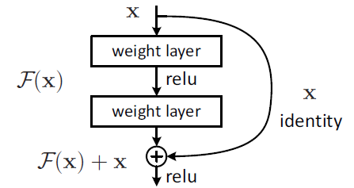
Skip Connection and Residual Blocks
Topologies: ResNets, DenseNet
[4] Kaiming He, Xiangyu Zhang, Shaoqing Ren, Jian Sun Deep Residual Learning for Image Recognition (2015)
[5] Gao Huang, Zhuang Liu, Laurens van der Maaten, Kilian Q. Weinberger Densely Connected Convolutional Networks (2016)

Slide 31
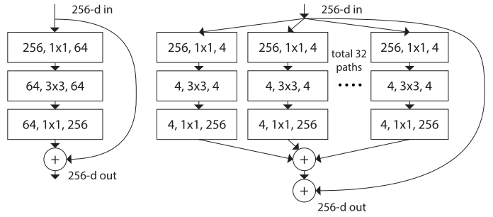
ResNeXt blocks
Topologies: ResNeXts
[6] Saining Xie, Ross Girshick, Piotr Dollár, Zhuowen Tu, Kaiming He Aggregated Residual Transformations for Deep Neural Networks (2016)

Slide 32
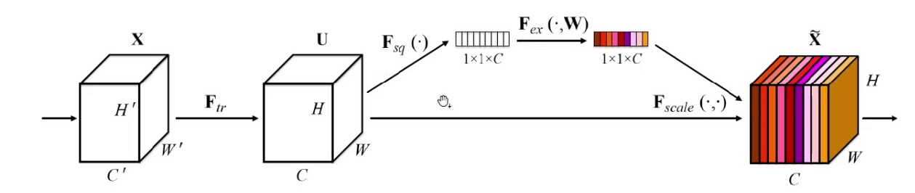
Squeeze and Excitation Block
Topologies: SE-net
[7] Jie Hu, Li Shen, Samuel Albanie, Gang Sun, Enhua Wu Squeeze-and-Excitation Networks

Slide 33


AlexNet
[8] Alex Krizhevsky, Ilya Sutskever, Geoffrey E. Hinton ImageNet Classification with Deep Convolutional Neural Networks (2012)

Slide 34

VGG
VGG-19:
Top-1 error: 25.5
Top-5 error: 8.0
[9] Karen Simonyan, Andrew Zisserman Very Deep Convolutional Networks for Large-Scale Image Recognition (2014)

Slide 35

GoogleNet and Inceptions
[2] Christian Szegedy, Wei Liu, Yangqing Jia, Pierre Sermanet, Scott Reed, Dragomir Anguelov, Dumitru Erhan, Vincent Vanhoucke, Andrew Rabinovich Going deeper with convolutions (2014)

Slide 36

ResNets
[4] Kaiming He, Xiangyu Zhang, Shaoqing Ren, Jian Sun Deep Residual Learning for Image Recognition (2015)

Slide 37



Data Augmentation. Transformations
Data augmentation - more data with all available cases:
affine transformations, flips, crop, contrast, noise, scale
pseudo-labeling

Slide 38




Regularization
Momentum (prevent the variations on error surface)
$$∆w^{(t)}=−α∇L\left(w^{\left(t\right)}\right)+\underset{momentum}{\underbrace{β∆w^{(t−1)}}}$$
LR decay (make smaller steps near optimum)
$$α^{(t)}=kα^{(t−1)}, 0<k<1$$
Weight Decay (prevent weight growing, and smooth F)
$$L^{∗}=L+λ\left\|w^{(t)}\right\|$$
Typical: $β=0.9$
Typical: apply LR decay ($k=0.1$) each 10..100 epochs
Typical: $L2$ with $λ =0.0005$
L1 or L2 regularization often used

Slide 39
Not too much Data - What We Can Do?
A few dozens of thousands of samples – is just “not bad” dataset
A few hundreds of thousands of samples – is good dataset
Overfitting is problem even for datasets with several millions samples

Slide 40
Transfer Learning
Source task
Target task
Learning system
Storing knowledge gained while solving one problem and applying it to a different but related problem
Knowledge
Learning system

Slide 41

Transfer Learning as a Fine-Tuning for NN
1) Train on Source Task
3) Add new last layers
2) Remove last layers
4) Train net for Target Task
Fine-Tuning may be considered as a good initialization strategy for deep NN
[10] Chen Sun, Abhinav Shrivastava, Saurabh Singh, Abhinav Gupta Revisiting Unreasonable Effectiveness of Data in Deep Learning Era (2017)

